Slide 1


Data Science Portugal
#36
Machine Learning in Retail and Fraud Detection
September 4th, 2018 - Porto
Notes:
Welcome to Data Science Portugal #36
Community of Data Science enthusiasts
Cover different topics, technologies and business areas
Who’s attending for the first time?
Who isn’t from Porto?

Slide 2






Where are we?
/datascienceportugal
~ 1366
~ 552
/groups/datascienceportugal
/datascienceportugal
~ 891
/company/dspt
~ 980
@datascience_pt
~ 454
/DataSciencePortugal
datascienceportugal.slack.com
datascienceportugal.herokuapp.com
Notes:
The platforms where you can interact with us
Register on Slack for interactive communication
TODO: conformar estes numeros

Slide 3
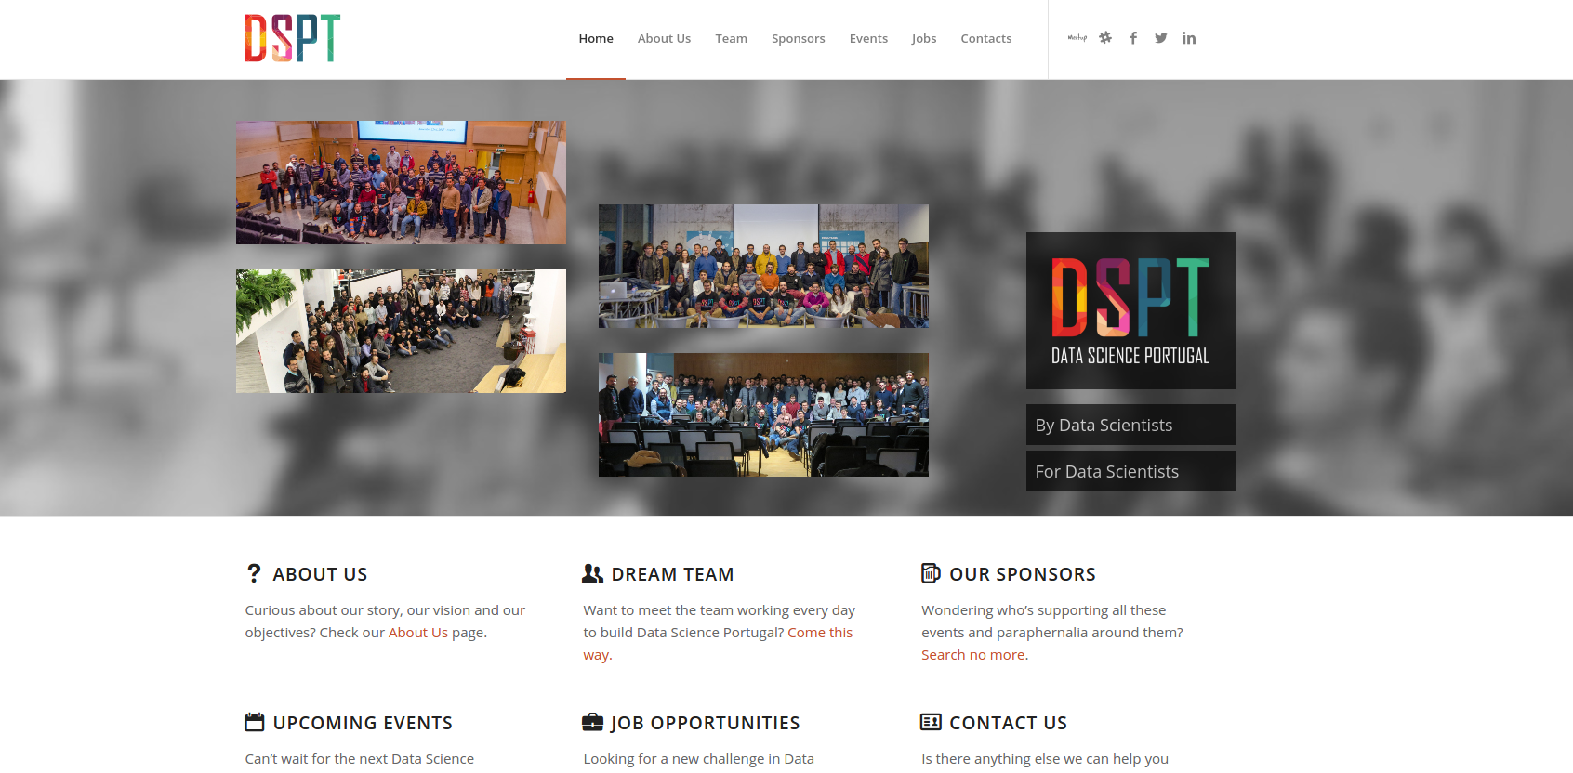
https://www.datascienceportugal.com
Notes:
Falar da Secção de Jobs e Eventos para ser colaborativo

Slide 4
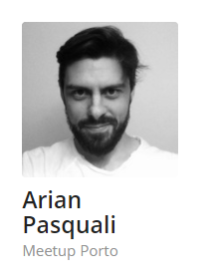
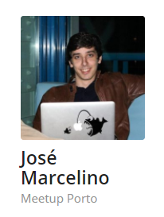
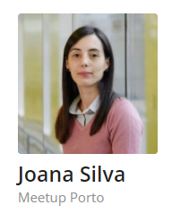
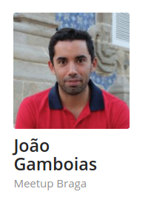
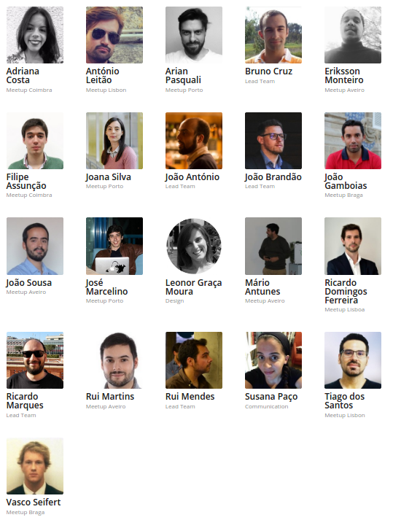
Team (Meetup Porto)

Slide 5























info@datascienceportugal.com
‹#›
Notes:
We’re independent but need help to continue our activities
Sponsor and support from external entities and companies
These are the entities that help us with coffee break sponsoring, space for meetups or both
If you’re interested, contact us at info@datascienceportugal.com
Soon we’ll launch a plan for long term partnership with DSPT (rather than pontual help)

Slide 6
The DSPT meetup #36 is sponsored by
Notes:
Thank you Ubiwhere for the coffee break for today
Thank you IEUA for the venue

Slide 7

Agenda
18:30 - 19:00 | Welcome and get together
19:00 - 19:30 | "Customer retention, the machine learning strategy” by Miguel Arantes, Inovretail
19:40 - 19:45 | Group Photo
19:45 - 20:15 | Networking / Beer Break
20:15 - 20:45 | "The Forefront of Fraud Fighting with Research” by Miguel Araújo - Feedzai
20:50 | Closing
21:00 | Dinner
Notes:
Jantar: Pedir para quem não se inscreveu, para fazer-lo até ao fim do intervalo.

Slide 8
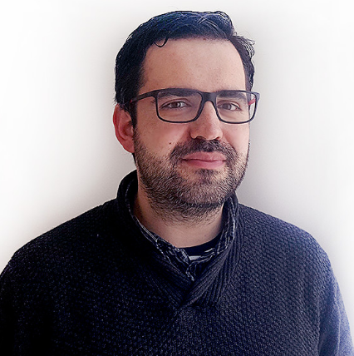
Customer retention, the machine learning strategy
Miguel Arantes, Inovretail

Slide 9

DSPT Events
#2 DSPT Workshop Deep Learning With Tensorflow
Delivered By Novabase
22nd September 2018 @ Coimbra
#1 DSPT Day
One day conference
6th October 2018 @ Porto
https://dsptday.com/
Workshop #2
DSPT Day 2018
‹#›

Slide 10

Networking / Beer Break
Sponsored by
Beer and Networking?
Not such a bad match!
‹#›
Notes:
Thank you Bosch and Feedzai for the coffee break for today

Slide 11
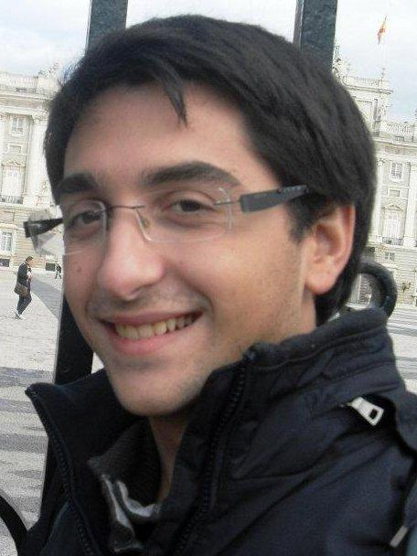
The Forefront of Fraud Fighting with Research
Miguel Araújo - Feedzai
‹#›

Slide 12
Thank you!
datascienceportugal.com
info@datascienceportugal.com
Notes:
And that’s it for today’s event! Now some of us will go have dinner together, and if you want to join, just feel free to stick around. Thank you.

